Slide 1
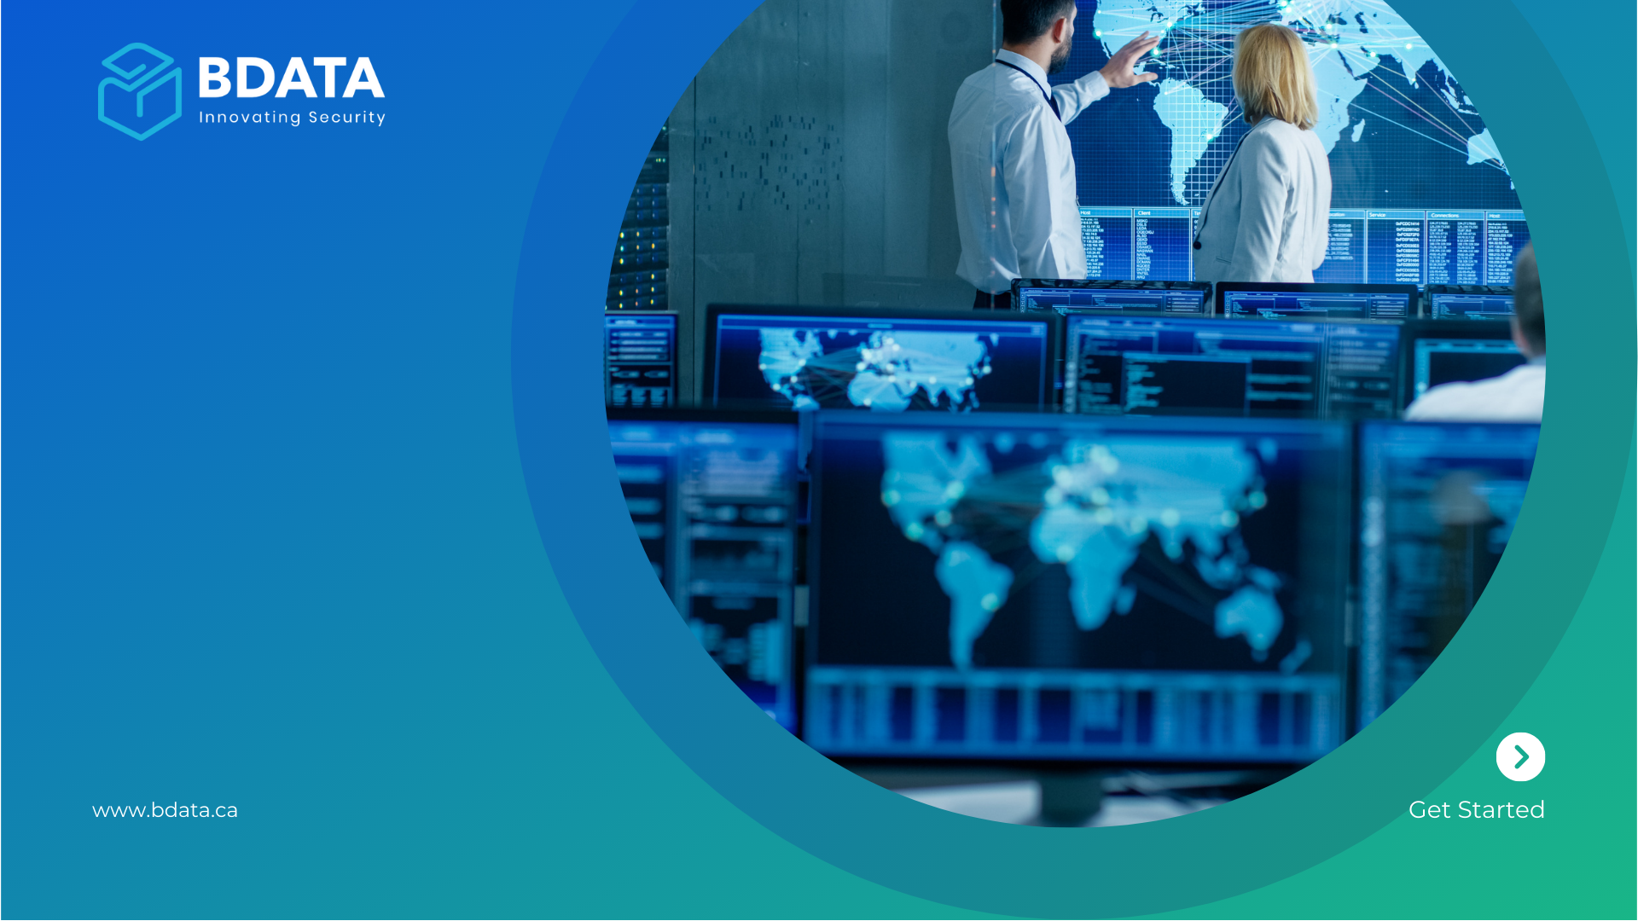
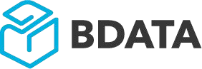
BDATA
BIoT Security
Technology
Validation & Adoption
Notes:
Thanks for joining, It’s the end of January so I guess, I can still wish you all, a blessed happy new year, my name is syed bari, I am the founder of BDATA, BDATA is a tech company out of Toronto, We have developed light weight cyber security technology, which help companies to avoid 3rd party and have a zero trust architecture implemented by design, In this webinar, I am going to talk about the cyber security challenges , and how to quickly resolve those challenges by using BIoT enabled ASUS Devices, which comes with multilayer cyber security pre-implemented and help companies to be focused on their digital transformation use cases rather spending time and money for implementing multilayer cyber security on edge devices.

Slide 2
Finished – Business Cases / PoC

Slide 3
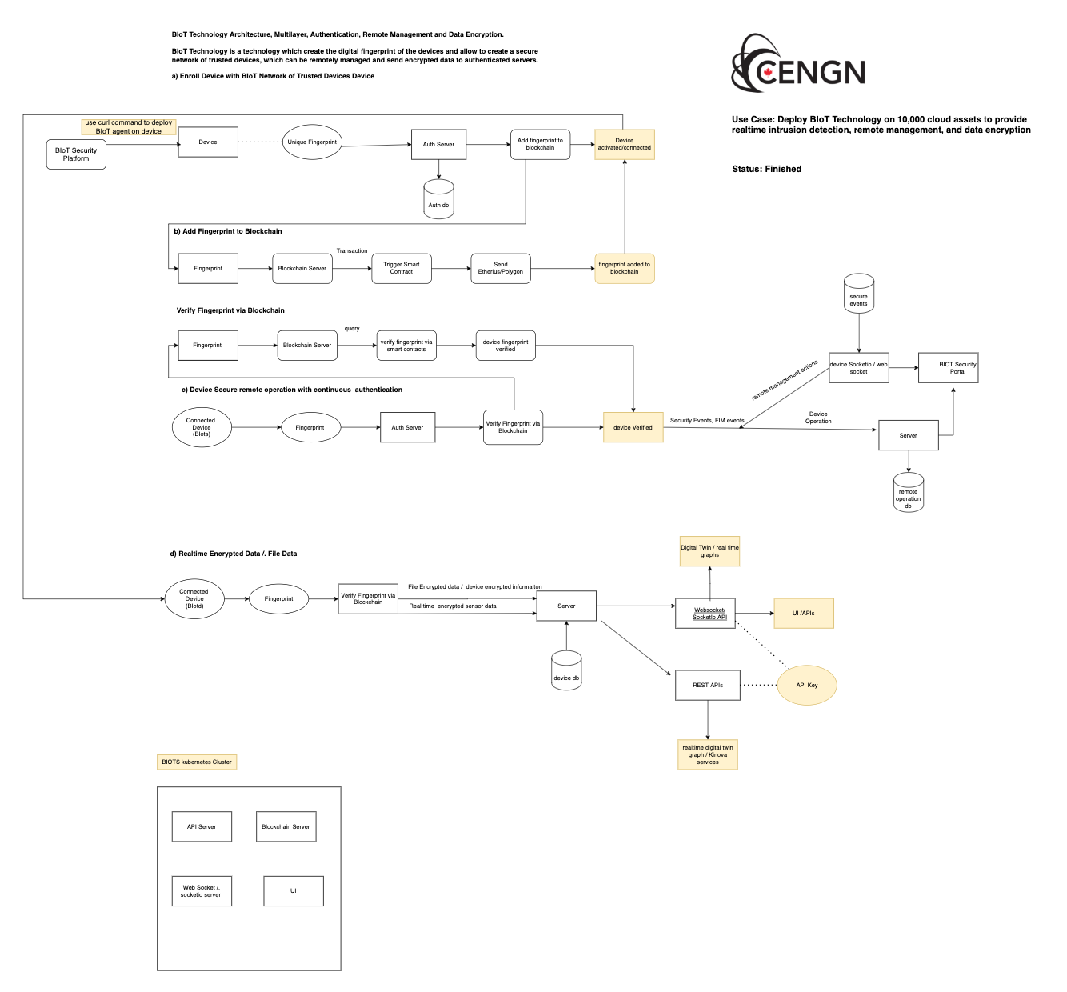

Use Case: Deploy BIoT blockchain-based authentication, secure remote management, intrusion detection, file integrity,
Number of Assets : 10,000
Status: Finished
Click on the link : Case study published

Slide 4
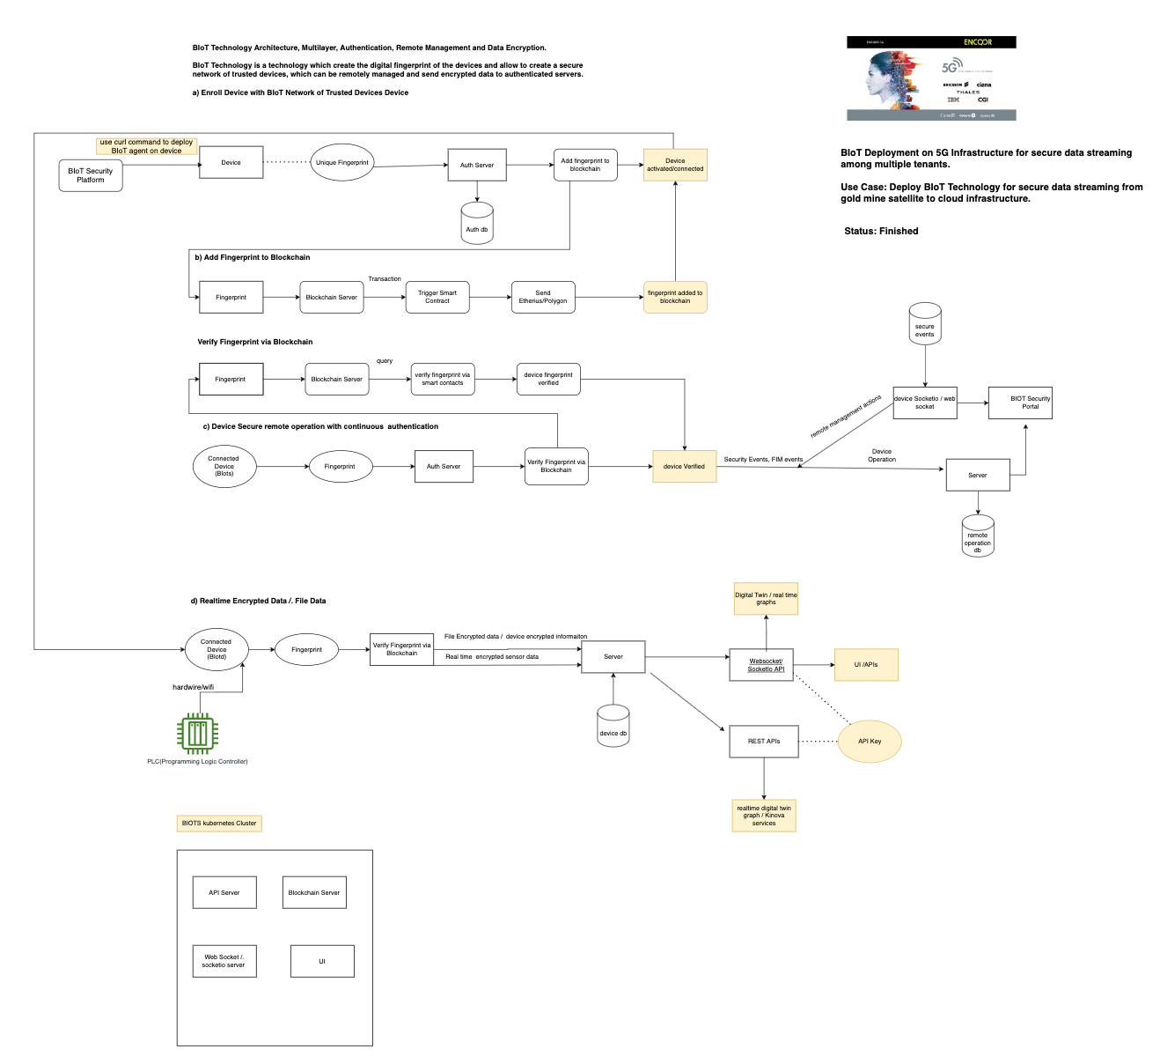
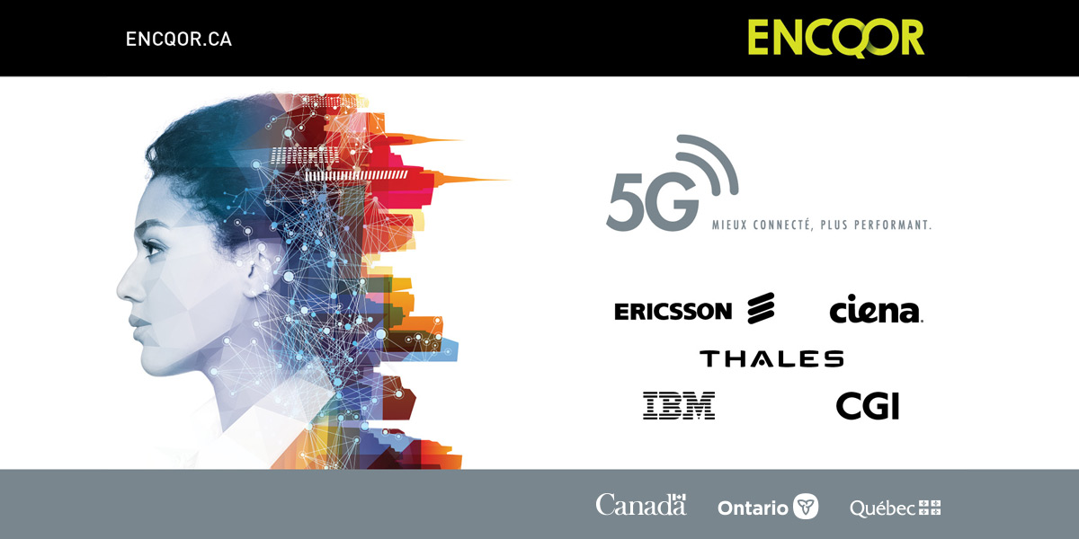
ENCQOR is a collaboration 5G test bed for paid PoC opportunity in partnership with the Ontario government, Nokia, Thales etc.
Use Case: Deploy BIoT Technology on 5G to stream data from PLC/Edge Device to Cloud.
Number of Devices: 10,000
Status: Finished

Slide 5

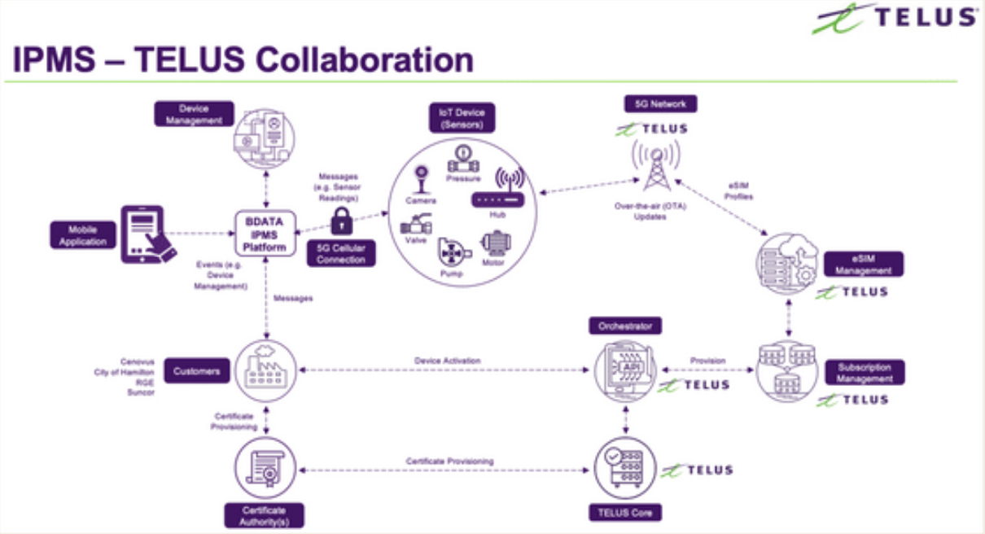
BIoT Enabled Secure – esim
Which provide esim integration with device to avoid certificate stolen.
Status: Finished

Slide 6
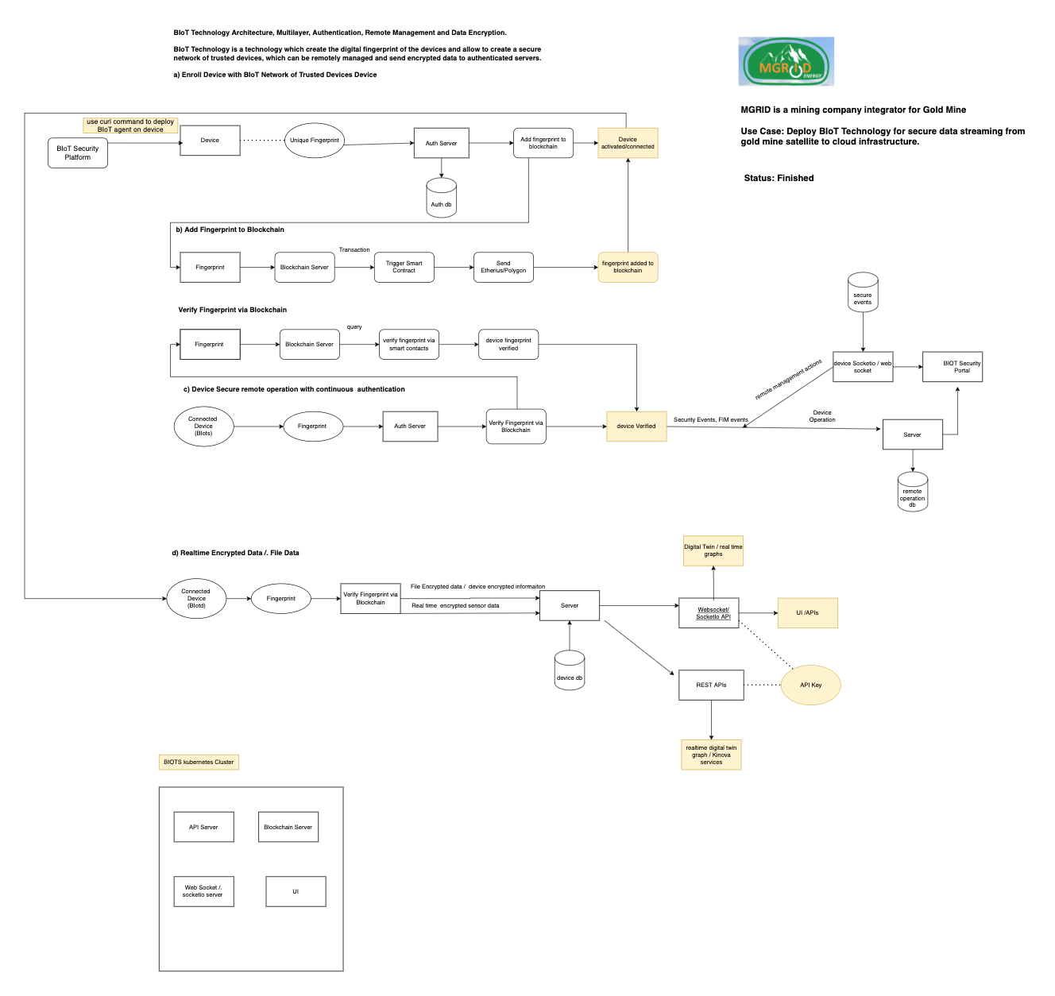

MGRID is a Yukon based mining system integrator, we provided BIoT technology for secure data streaming from satellite to cloud
Status: Finished

Slide 7
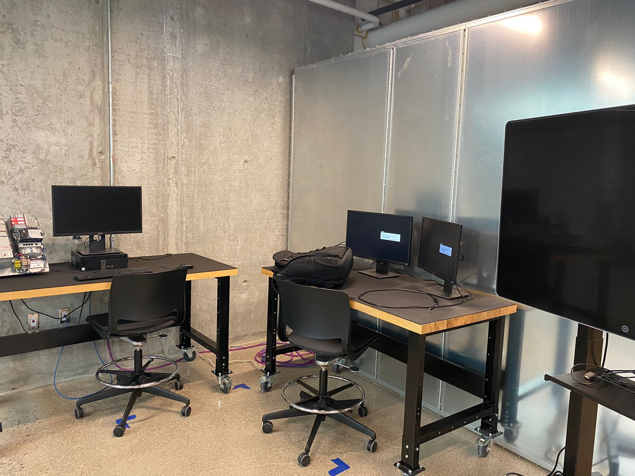
Humber College Lab

Slide 8
Pipeline Projects – 2022 Q3/Q4

Slide 9
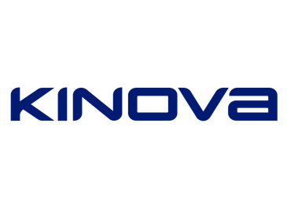
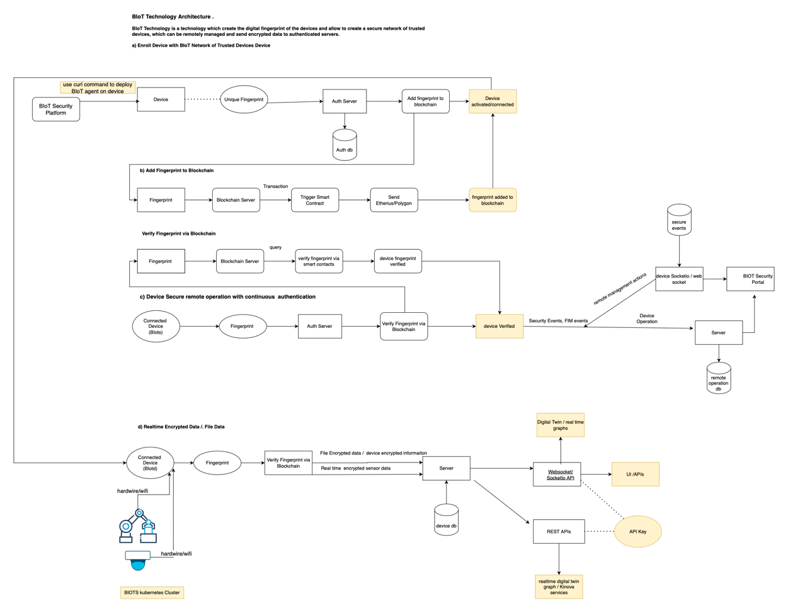
KINOVA is a robotic company out of Montreal,
Use Case: Deploy BIoT for Cloud-based secure Robotic - Operation
Number of Devices : 3500

Slide 10

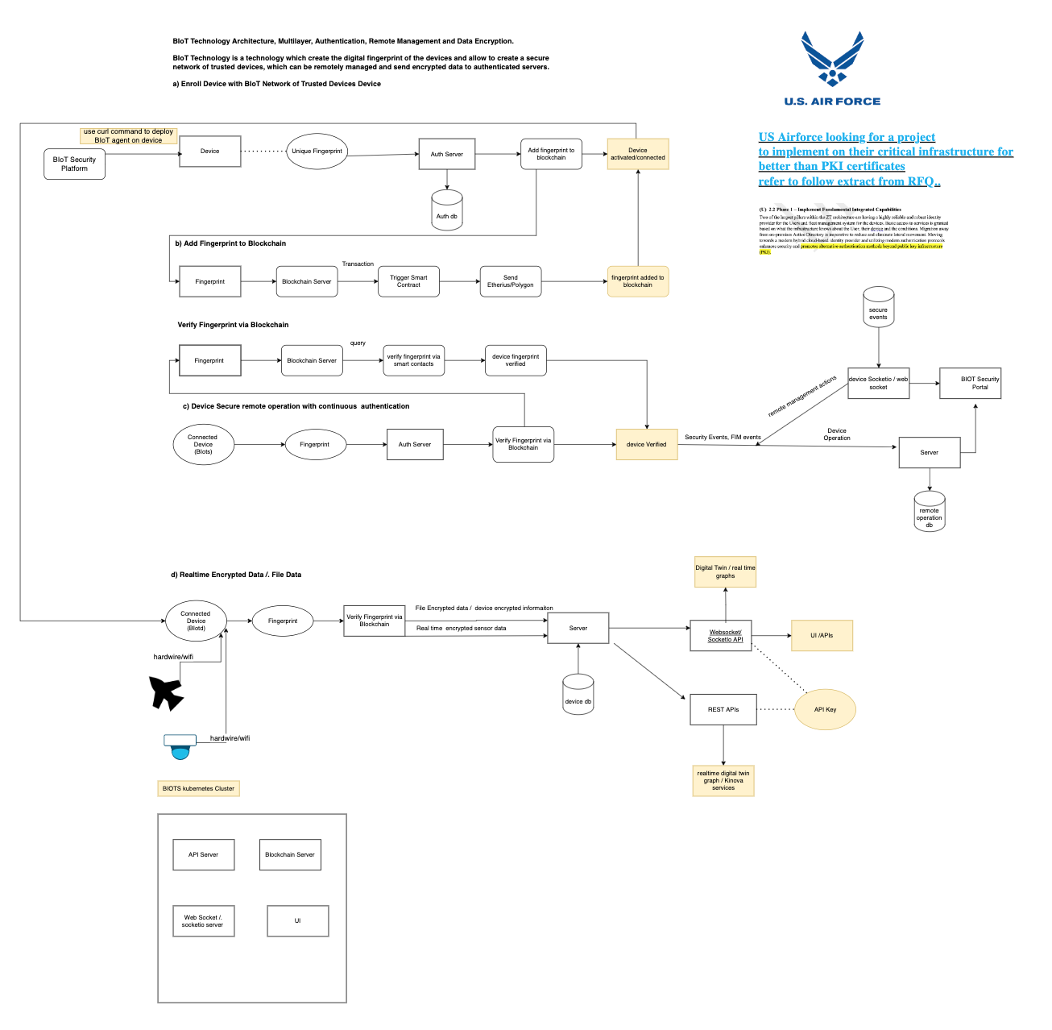
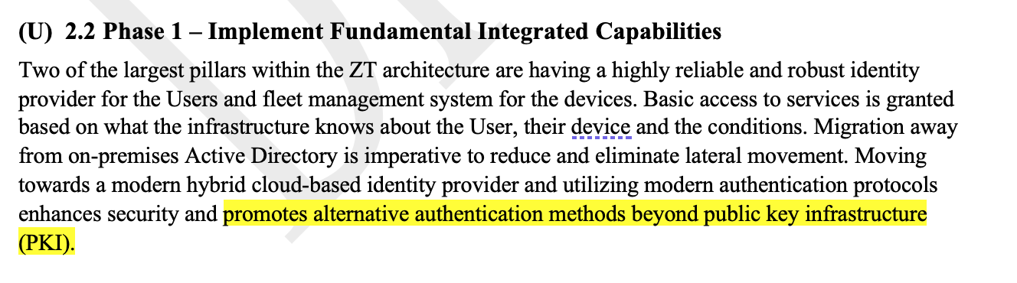
US Airforce looking for a project to implement on their critical infrastructure for better than PKI certificates refer to follow extract from RFQ..
Use Case: Better layer for
cyber security

Slide 11
Canadian Defence
Use Case:
- Apply BIoT on one of the defence ship

Slide 12

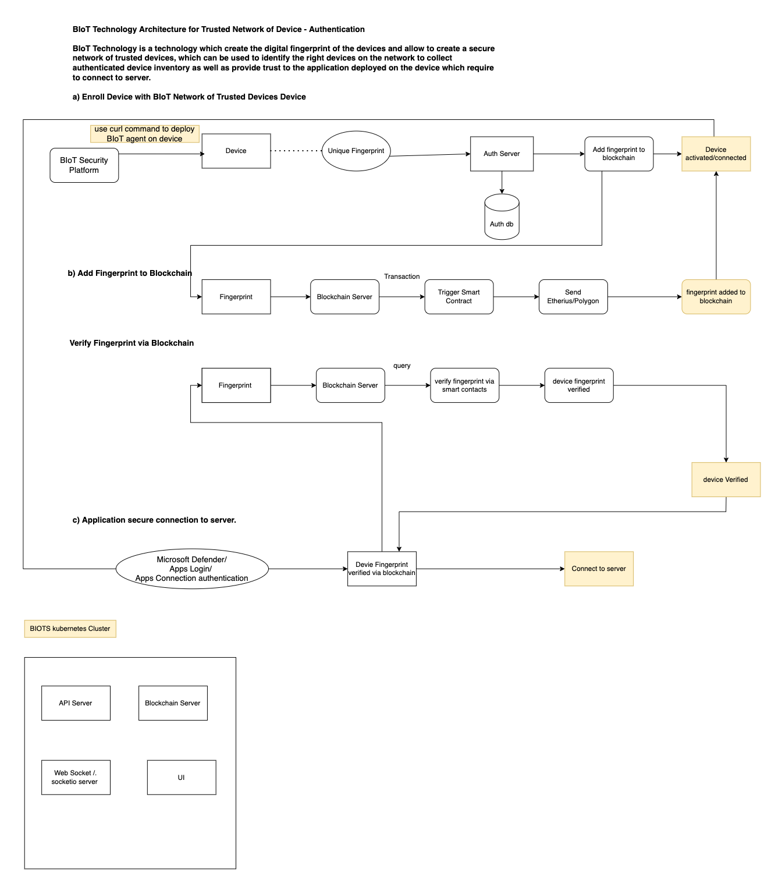
Yokogawa is a global automation company.
Use Case: Deploy BIoT for Edge Devices
Number of Devices : 27000
Next Meeting , 6 Aug

Slide 13
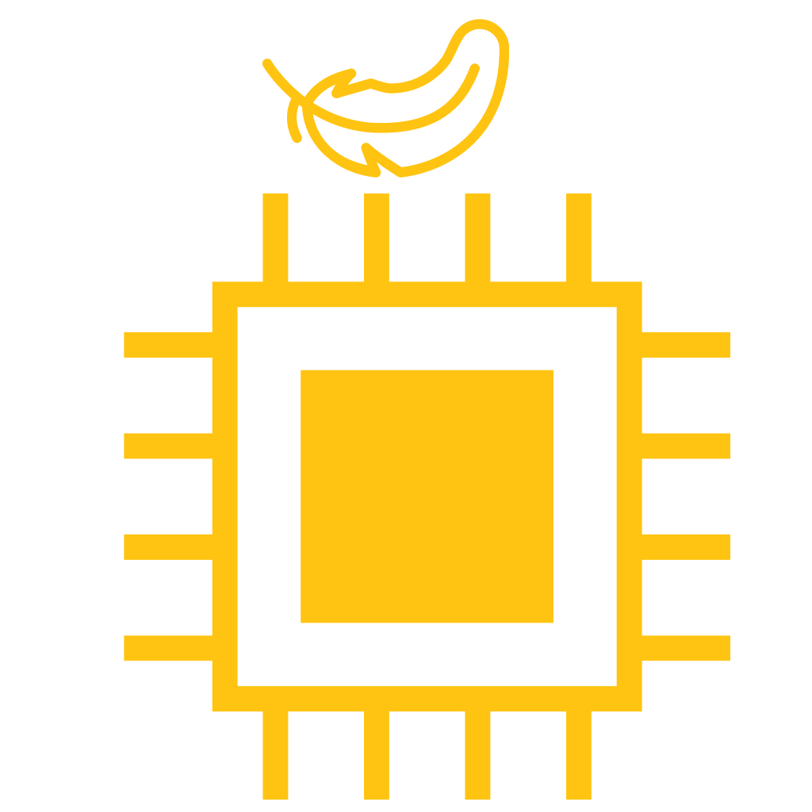
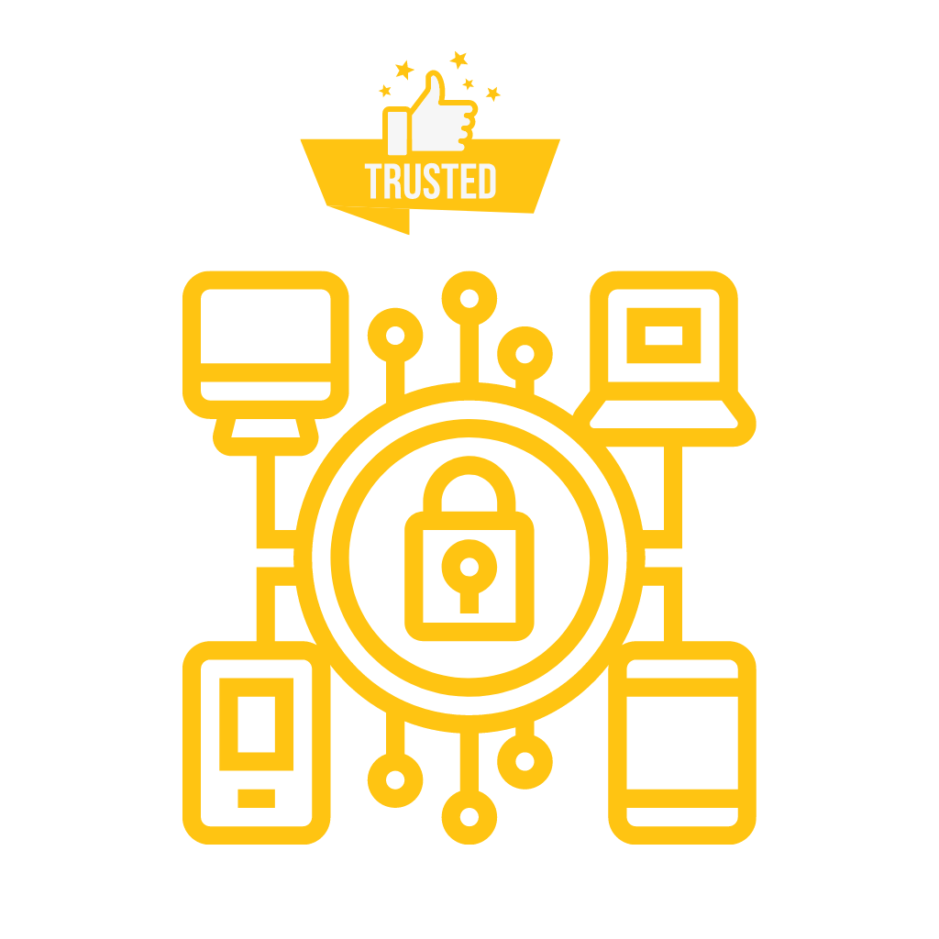
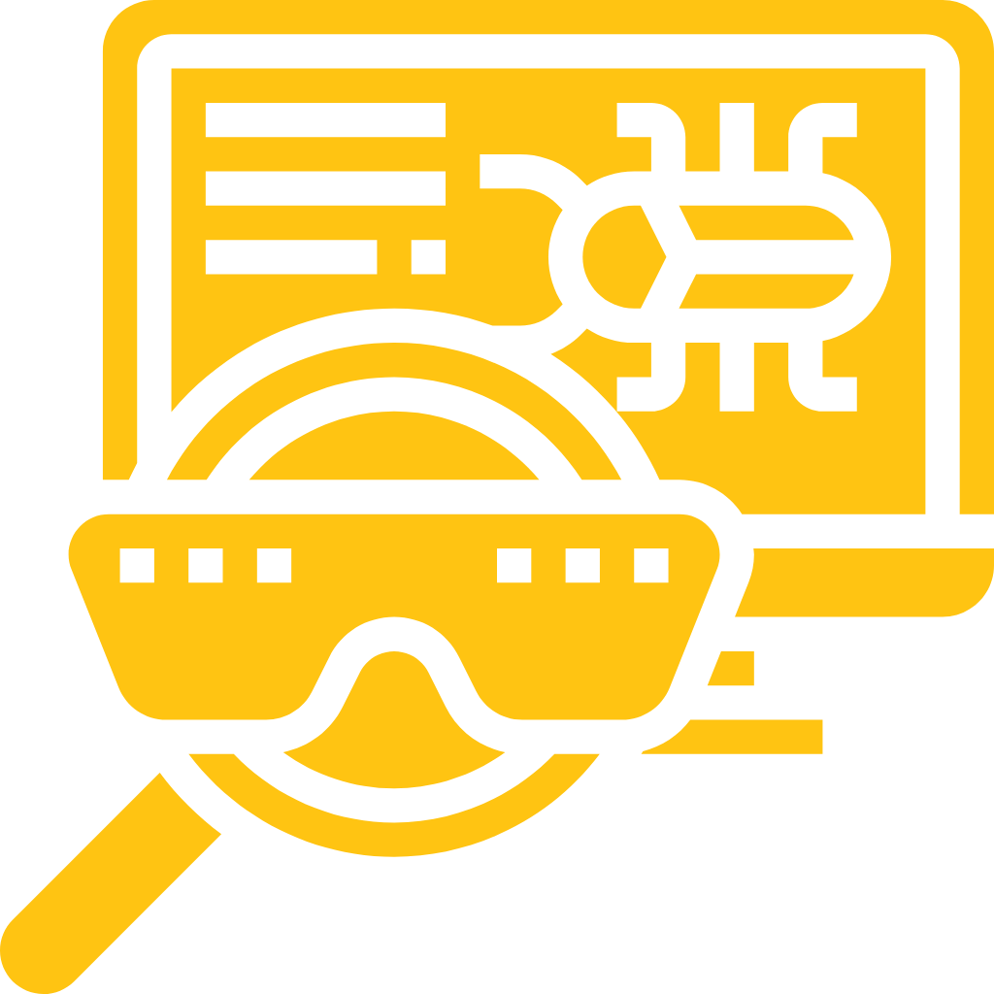
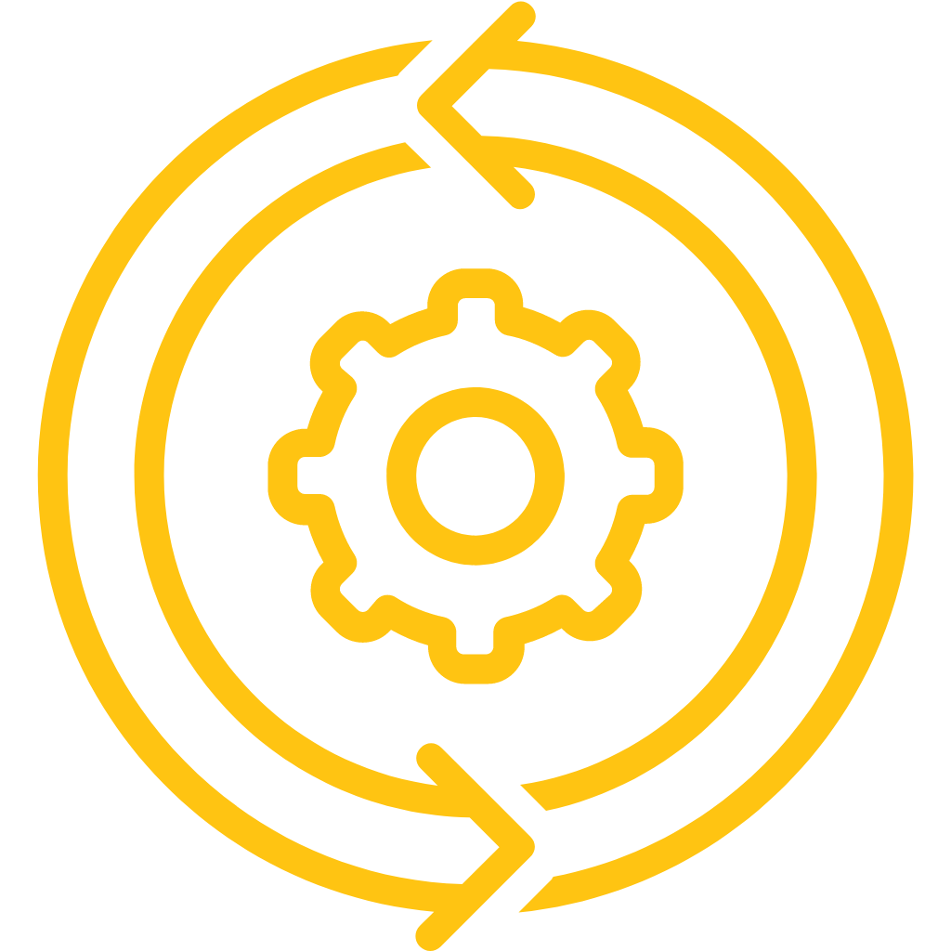
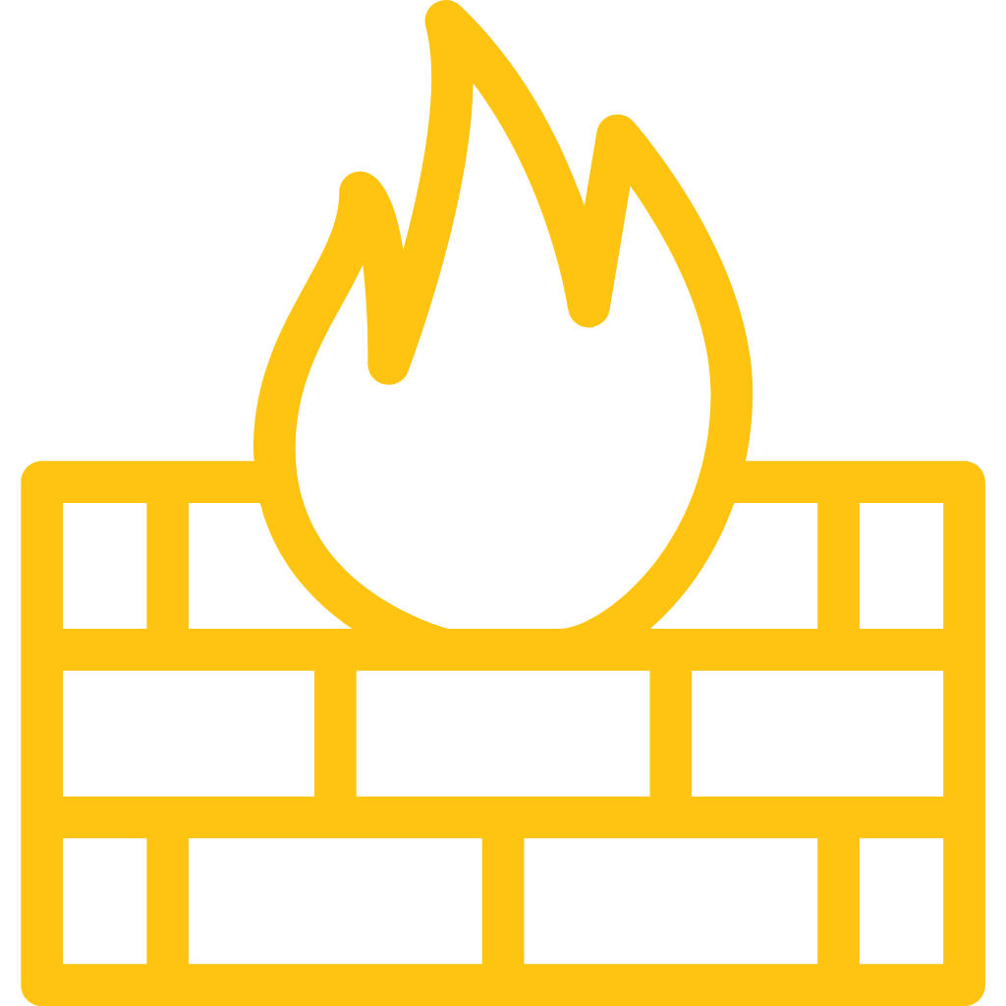
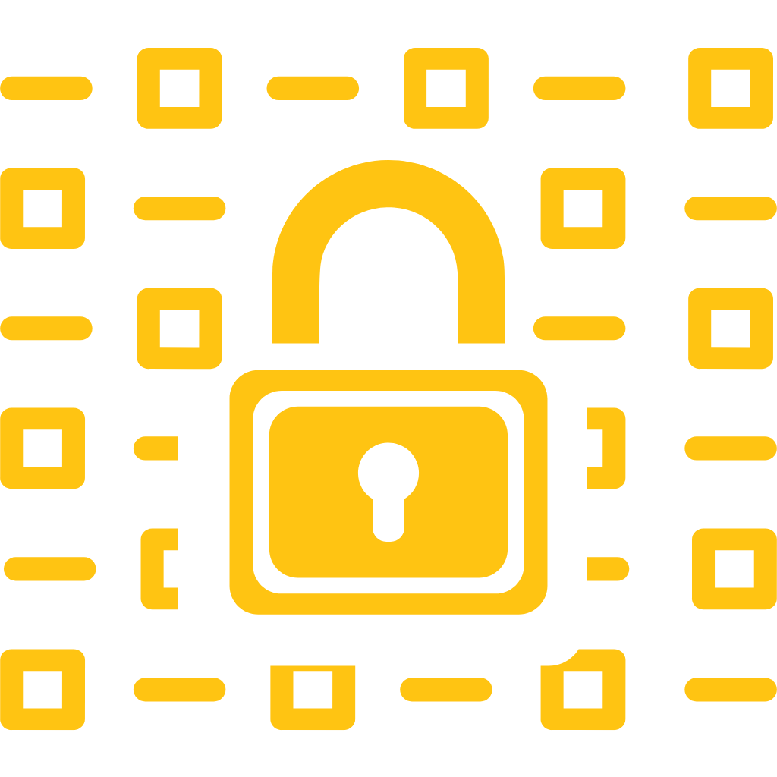
Key Value of the BIoT Technology
Lightweight
Network of
Trusted Devices
Multilayer Attack
Detection
Continuous
Authentication
End to End Data
Encryption
Firewall
Management

Slide 14
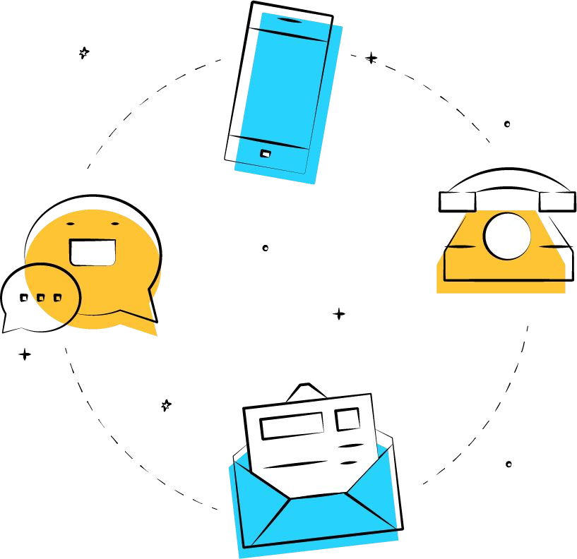
Contact Us
info@bdata. ca www.bdata.ca
Notes:
Thanks for joining, please visit our website to know more about technology, team and use cases.

